Slide 1
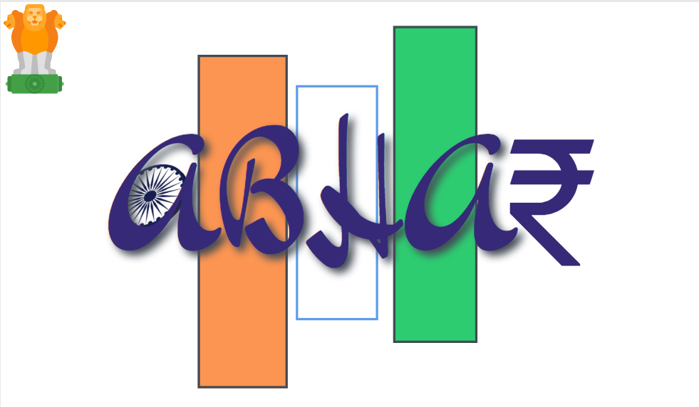
Project Aabhar
Anuj Garg2/India/IBM
Mani Madhukar1/India/IBM
Shikha Maheshwari/India/IBM
https://github.com/anuj741/PMCaresDonationTracking
Notes:
This is a discussion on the state of the blockchain market and what different competitiors are doing. Presentations in the “Blockchain for IBMers” series are:
Engagement Model: How to progress blockchain opportunities
Garages: How to engage the IBM Blockchain garages
Design Thinking Workshops: How to run a Design Thinking Workshop
Competitive Differentiators: Market and Competitive outlook
Public References: Client success stories
This presentation uses the IBM Plex font family, which can be downloaded here: https://ibm.ent.box.com/s/j90l2qhgjfysu6laq1rnt1anxspqxdcb/folder/30078036973

Slide 2
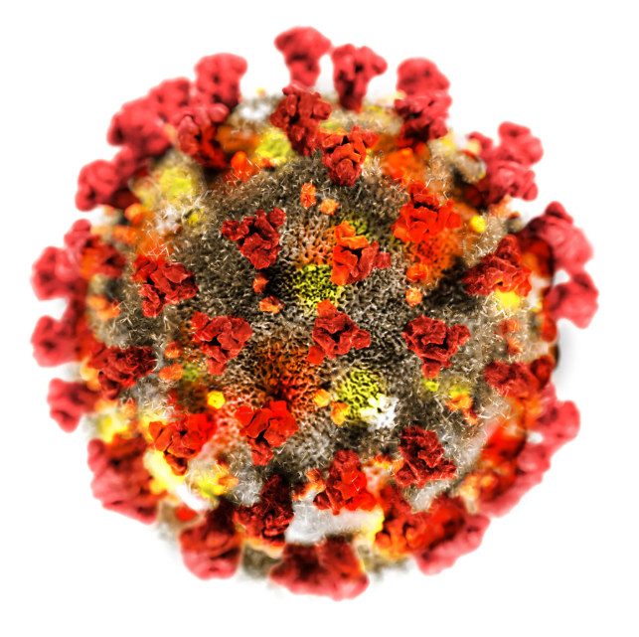
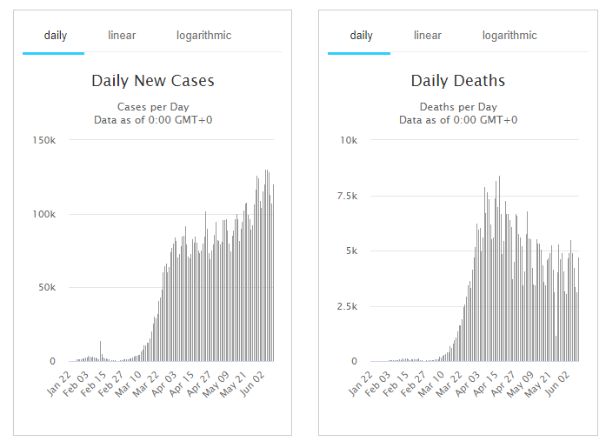
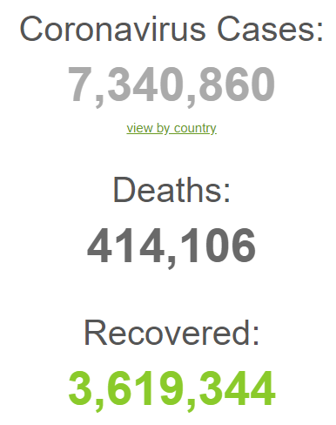
Covid – 19
The Biggest Pandemic of our times
India tally of Covid-19 patients above 265k.
India ranks at 5th place in the world as of now.
Indian government has announced big relief package to tackle the situation and control the pandemic.
India among the major players hoping to come forward with vaccine.

Slide 3

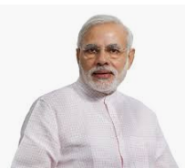
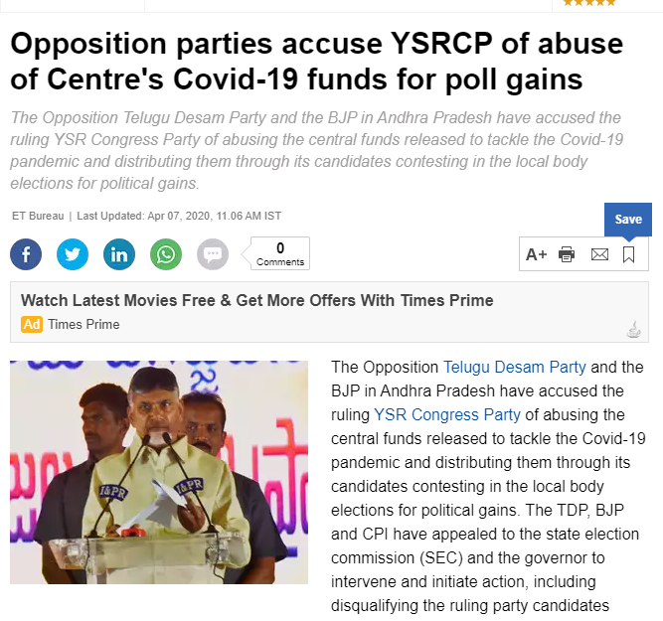
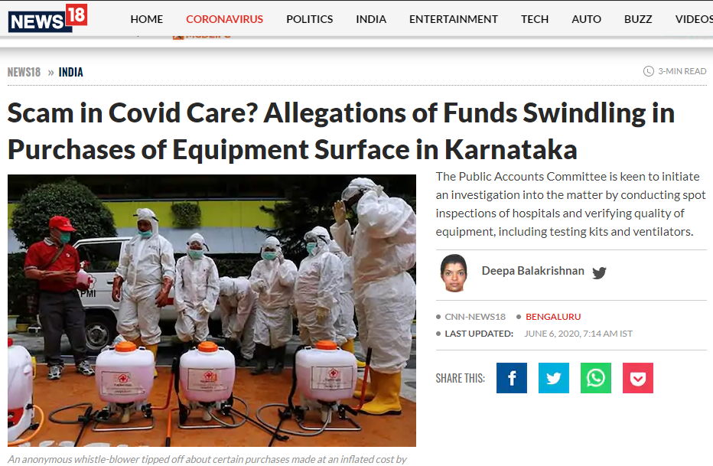
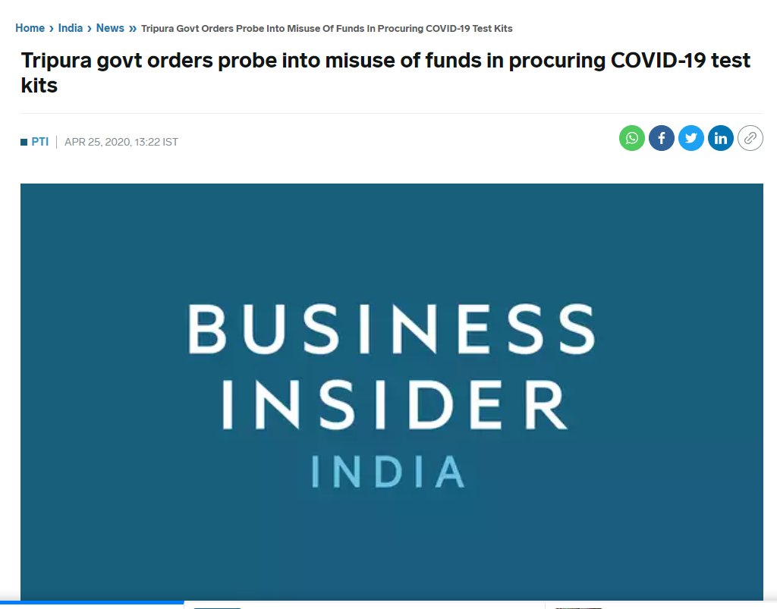
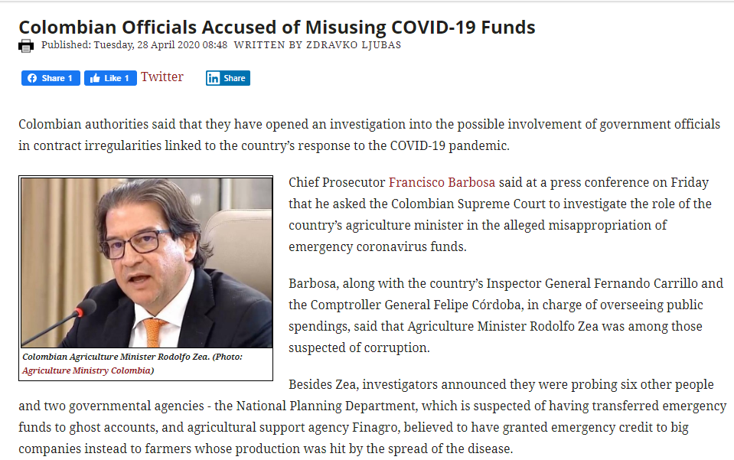
Indian Prime Minister announced special fund called PMCARES to provide relief to Indian population suffering due this pandemic.
PMCARES fund has received huge donations from corporate and entertainment industry with the overall corpus more than Rs 10000 Crore.
While the fund is being used for the welfare of the society lot of questions are being raised on the usage of the funds and involved corruption and ability to reach to the last mile.

Slide 4
Project Abstract
During pandemics such as Covid-19 lot many donators come up with hefty donations to help and rescue the people. Once the donation is done, there is no way to identify if the money is used for the right cause and where exactly it is used. Blockchain based solution can help to track the money till the last point.
No Transparency of Funds
Money can be easily siphoned off and not used in actual work
The system can be used for Black to White conversion of Money
No real time log or audit trail for the money spent.
No standard database for log of activities and lesson learnt

Slide 5
Proposed System
Blockchain Technology enables secured and transparent money transactions with the audit log of every Rs spent. The proposed creates a Blockchain based data platform to store and retrieve the donation information for the PMCare fund.
Create Donation Platform
Any valid user can donate the money for a particular cause using payment gateway.
Blockchain Based Data Platform
Create distributed ledger of information
Enable secure and restricted access to update the database to the registered sources.
Smart Contract / Robots to drive currency distribution
Software robots on top of distributed ledger to implement rules of currency distribution.
Real time log available to track each and every coin
Transparency of Funds
Any donor or system user can see the transactions related to his/her money at any point of time.
Complete transparency of every penny spent.
Removal of Intermediaries
Information sharing will lead to faster response and operations at ground level as all participants will find the need of their assets.
Ability to add/remove participants in real time and add / remove assets as and then they are added or consumed.
Real time Audit trail of Funds
Monitoring of relief operations on real time basis by authorities.
Real time audit trail of information for audits and lesson learnt.

Slide 6
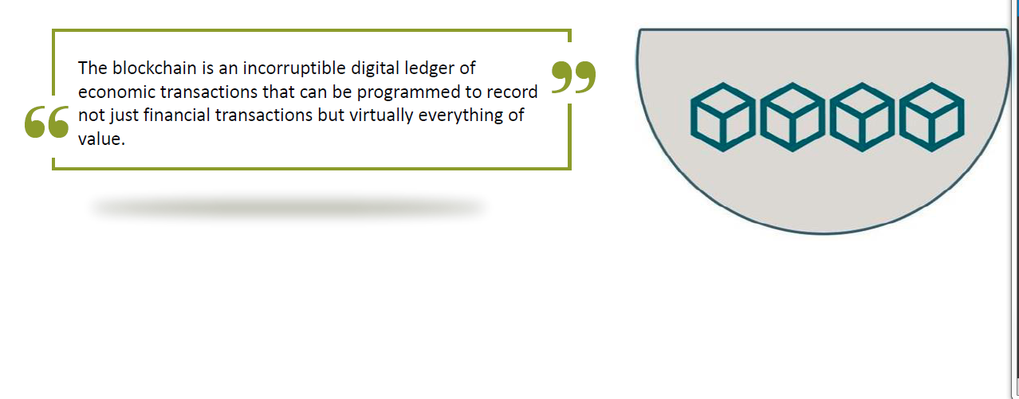
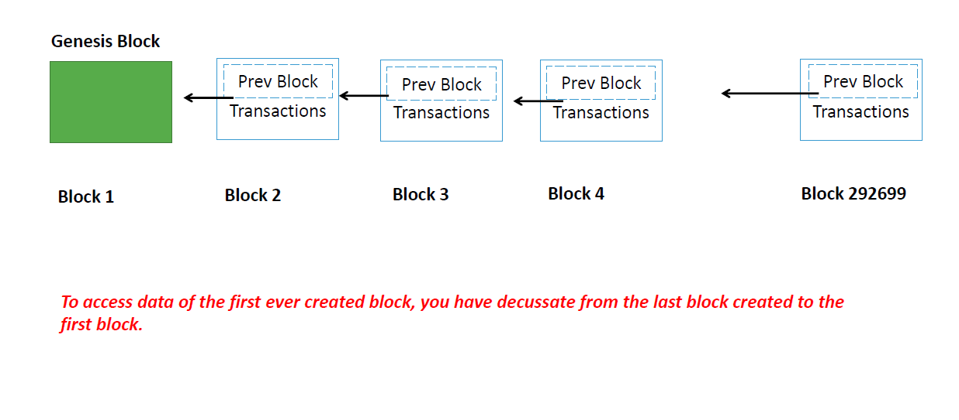
Why Blockchain?
Immutability
Transparency
Real Time Settlements
Decentralized Architecture
Audit Ready

Slide 7







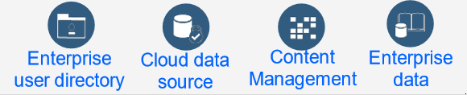
High Level Design
Donors
Fund Seekers
App
App
Auditors and Approvers
Fund donation/Fund tracking requests
Fund Requests
Acknowledgement/Tracking Reports
Funds Approval/Rejection Responses
Validation Requests for Donors and Fund seekers
Blockchain Network
Validation Responses
Smart Contract
Events
App
CA
Ordering Service
Existing System of records

Slide 8
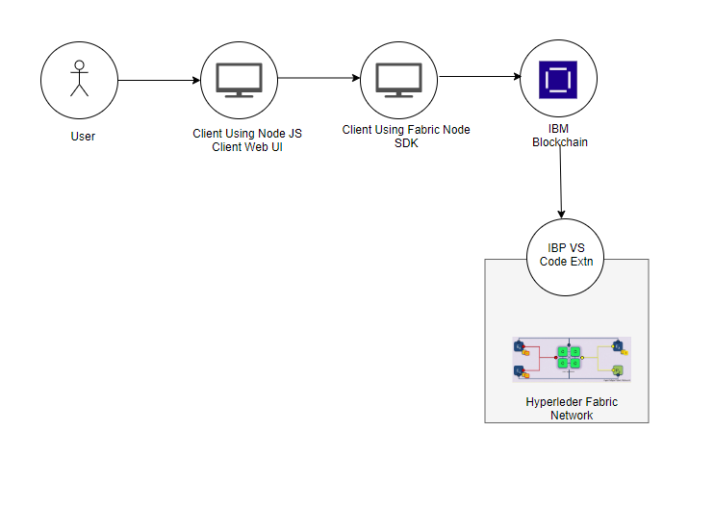
Architecture Diagram

Slide 9
Github Source Code Repository
https://github.com/anuj741/PMCaresDonationTracking
Demo

Slide 10
Results
Working Hyperledger Fabric based platform to collect and keep track of donations made to the PMCares fund.
Working platform to distribute funds to beneficiaries tracked by Blockchain technology.
Working platform to view transactions and reports of the donors and fund seekers.
Bringing transparency from audit and compliance of view to usage of PMCares fund.
Next Step
Incorporate authentication mechanism for registering donors and charitable organizations (seeking funds) using Aadhar Id.
Add auditing organization such as CAG to ensure complete transparency and that the money is coming from valid sources and is going to valid source.
Enable real time fund tracking for individuals based on their signing credentials, to instil faith in PMCares fund institution.
Enable the app for Android and IOS based mobile platforms.
Enable generation of donation certificates and tax certificates for donors.
Integration with payment gateways such as banks, credit cards, digital wallets etc.
Detailed reports on all transactions and breakup per user.

